Slide 1

DAMEO: AI SEARCH-BASED AGENT
EIACD ASSIGNMENT
Henrique Pilão (up202405162)|Paulo Pereira (up202406285) | EIACD - PL3 | FCUP & FEUP

Slide 2
Game Specification and Development Approach
-> Dameo is played on an 8x8 board with 18 pieces per player, arranged in a trapezoidal formation.
-> Pieces move forward, and kings can move in all eight directions.
-> Capturing is mandatory and involves orthogonal jumps.
-> Objective: Capture all opponent pieces or force them into a position with no legal moves.
-> We will implement a search-based AI agent to play Dameo.
-> We will employ the minimax algorithm with alpha-beta pruning to navigate the game tree.
-> Heuristic evaluation functions will be developed to assess board states.
-> Implementation will be in Python, utilizing appropriate data structures for board representation and move generation.

Slide 3
Related Work:
-> Research on AI for board games, particularly checkers and chess, serves as a theoretical foundation for our approach.
-> Minimax and alpha-beta pruning are widely used techniques in game AI, as discussed by Russell & Norvig in Artificial Intelligence: A Modern Approach.
-> We will investigate existing open-source checkers/draughts AI implementations for potential insights (GitHub repositories)
-> We will investigate existing open-source checkers/draughts AI implementations for potential insights (GitHub repositories)
-> Web resources detailing Dameo variations and strategies. (Dameo - Wikipedia)

Slide 4
STATE REPRESENTATION:
OPERATORS (MOVES):
Problem Formulation as a Search Problem
Heuristics/Evaluation Functions: "Piece count (number of player pieces - number of opponent pieces)." "King count (number of player kings - number of opponent kings)." "Positioning (evaluating control of the center and advancement)." "Potential captures (number of potential capture moves available)."
An 8x8 matrix to represent the board, with elements indicating player pieces, kings, or empty cells.
'B' for black piece, 'W' for white piece, 'K' for black king, 'Q' for white king, '0' for empty."
Forward move (name: forwardMove, preconditions: valid forward square, effects: piece moves, cost: 1).
Forward diagonal move (name: diagonalMove, preconditions: valid diagonal square, effects: piece moves, cost: 1).
Capture jump (name: captureJump, preconditions: opponent piece adjacent, empty square beyond, effects: piece jumps, opponent piece removed, cost: 1).
King moves (name: kingMove, preconditions: valid square in 8 directions, effects: king moves, cost: 1).
King Capture jump (name: kingCapture, preconditions: opponent piece in line of sight, empty square beyond, effects: king jumps, opponent piece removed, cost: 1).
INICIAL STATE:
The standard Dameo starting position, with pieces arranged in the trapezoidal formation.
OBJECTIVE TEST:
Check if either player has no remaining pieces or no legal moves.

Slide 5



IMPLEMENTATION PROGRESS:
File Structure:
-> board.py (board representation and move generation).
-> agent.py (AI agent implementation, minimax, heuristics).
-> game.py (game logic and interface). Algorithms:
-> Move generation algorithm implemented.
-> Basic board state evaluation implemented.
-> Initial Minimax implementation started.
Text/Graphical Interface:
-> Text-based interface for testing implemented.
-> Potential future implementation of a graphical interface using Pygame.
Piece count (number of player pieces - number of opponent pieces). King count (number of player kings - number of opponent kings). Positioning (evaluating control of the center and advancement). Potential captures (number of potential capture moves available).
Heuristics/Evaluation Functions:
Development Environment:
-> Python 3.x
-> IDE: VS Code
Data Structures:
-> 2D list (matrix) for board representation.
-> Lists to store legal moves.
-> Possible use of classes to represent pieces and moves.

Slide 6
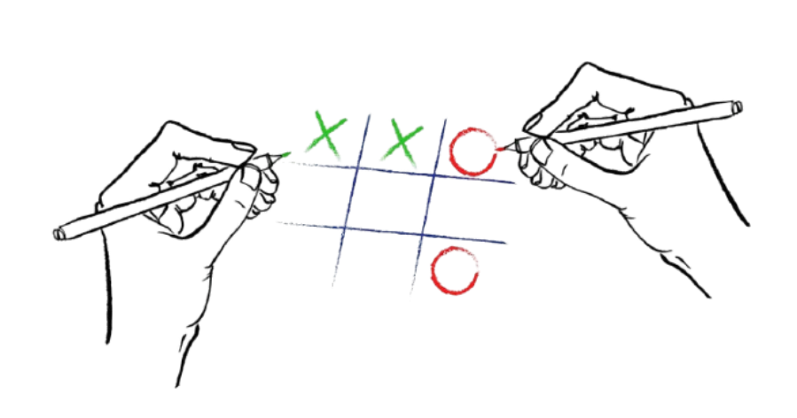
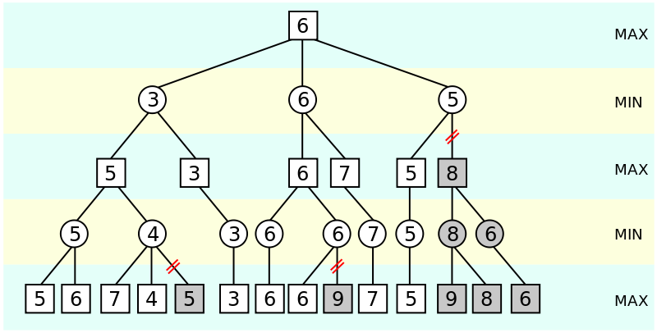

Algoritmos Implementados
Minimax com cortes αβ:
Busca Adversarial:
Heurísticas:
Algoritmo de busca para jogos, otimiza a busca minimizando as possibilidades exploradas.
Avalia melhor jogada considerando as jogadas do oponente.
Mobilidade, controle do centro, segurança e promoção de peças.

Slide 7
Heurísticas e Funções de Utilidade
Heurísticas:
Mobilidade: número de movimentos possíveis de uma peça.
Controle do Centro: número de peças próximas ao centro do tabuleiro.
Segurança: peças mais protegidas têm maior valor.
Função de utilidade:
Calcula a pontuação do estado do tabuleiro, com base em peças e posicionamento.
Operadores:
Movimentos, capturas e promoções das peças.

Slide 8
Resultados Experimentais (Comparação de Algoritmos e Heurísticas)
Minimax αβ vs. Minimax simples:
Dificuldade de Jogo:
Melhora o desempenho eliminando ramos de busca desnecessários.
Algoritmos mais complexos (como MCTS) são mais eficazes em jogos difíceis.
Heurísticas:
A heurística de controle do centro demonstrou ser mais eficiente em níveis mais altos de dificuldade.

Slide 9
Interface Gráfica e Funcionalidades
Desenho do Tabuleiro:
Tabuleiro quadrado com alternância de cores (bege e verde escuro).
Interação:
Suporte para selecionar peças e indicar movimentos possíveis.
Seleção e Movimentos Possíveis:
Destaque para peças selecionadas e caminhos possíveis.
Peças:
Representação das peças como círculos (brancos e negros), com indicações para reis.

Slide 10
Conclusões e Trabalho Relacionado
Desafios:
-> Implementação de IA competitiva com diferentes algoritmos.
-> Melhoria na eficiência de busca em tempos limitados.
Resultados de Aprendizagem:
-> Entendimento profundo de algoritmos de busca e heurísticas aplicadas em jogos.
Bibliografia:
Russell, S., & Norvig, P. (2021). Artificial Intelligence: A Modern Approach (4th ed.). Pearson.
GitHub Repository - Dameo Game: GitHub - stifler9/Dameo: Dameo game (similar to checkers)
OpenAI ChatGPT. (2025). Assistive AI for programming and game development. https://chat.openai.com.
Google Gemini. (2025). Assistive AI for programming and game design. https://gemini.google.

